Slide 1
General information for MATH 54
Lin Lin.林霖
https://math.berkeley.edu/~linlin/
Course website:
https://lin-lin.github.io/MATH54/

Slide 2
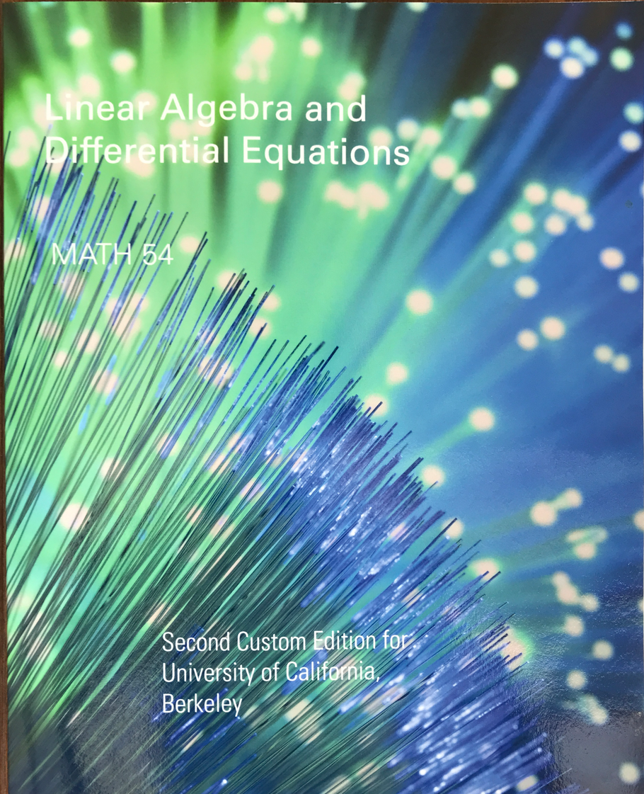
Two parts: Lay, Linear Algebra
Nagle-Saaf-Snider (NS&S), differential equation

Slide 3
Alternative textbooks:
5th and 6th (new to this custom version) editions of Lay, Lay, & McDonald’s Linear Algebra and Its Applications
9th edition of Nagle, Saff and Snider’s Fundamentals of Differential Equations
Previous versions of the custom edition, or the separate textbooks as above may work, but it is your responsibility to make sure that you are doing the correct problem sets for your homework.

Slide 4

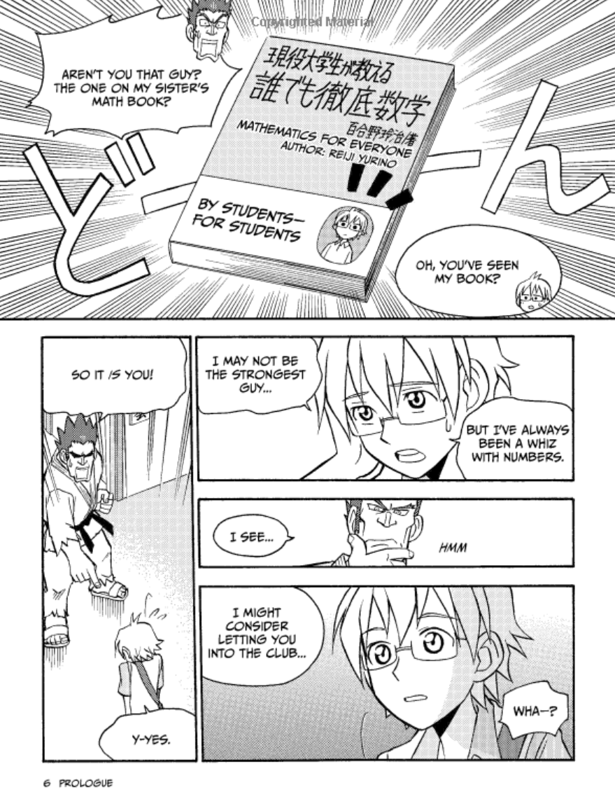
Not a valid alternative textbook: an example

Slide 5
Read the course policy very carefully.
Late submission = no credit.
No make-up exams.
DSP requests need to be made ASAP.
For administrative questions (*not covered* in the course policy): email the Lead GSI first: Jiahao Yao jiahaoyao@berkeley.edu

Slide 7
You will need materials taught in 54 in
Physics
Chemistry
Electrical engineering
Computer science
Materials science
Mechanical engineering
Civil engineering
Aerospace engineering
Robotics
Economics
Finance
Deep learning
Quantum computing
… or pretty much everywhere!

